Slide 1
Engineering Mathematics (part II)
Mathematical Methods for Physics
1
School of Science, BUPT
Xia Shi
shixia0402@sina.com

Slide 2
Chapter 7
Classification and Simplification for Linear Partial Differential Equations of Second Order
2

Slide 3
1. Classification of linear second order PDEs
The general form of the linear second order PDE with two variables is
where A, B, C, D, E, F and G are all given real functions with two variables (x,y) with
u=u(x,y) is the unknown function.
The discriminant is
Classification:
Hyperbolic type ( 双曲型 )
Parabolic type ( 抛物型 )
Elliptic type ( 椭圆型 )

Slide 4
1. Classification of linear second order PDEs
Take a transformation
with the Jacobi determinant
We have inverse transformation
1
A new second order linear equation of
2
with
The type isn’t changed !

Slide 5
2. Simplification of linear second order PDEs
characteristic equation

Slide 6
2. Simplification of linear second order PDEs
characteristic
curves
Canonical (standard) forms of linear second order PDEs
(i) Hyperbolic type
Take the transformation

Slide 7
2. Simplification of linear second order PDEs
(The first normal type)
On the other hand, if let
(The second normal type)

Slide 8
2. Simplification of linear second order PDEs
(ii) Parabolic type
characteristic equation
Take the transformation
Parabolic standard type
Take the transformation

Slide 9
2. Simplification of linear second order PDEs
(iii) Elliptic type
No real value solutions.
Two conjugate complex solutions
Take the transformation
Elliptic standard type

Slide 10
2. Simplification of linear second order PDEs
Simplify the following equations into their standard types.
Example 1.
Solution.
(1) Evaluate the discriminant.
hyperbolic type
(2) Write down its characteristic equation.
Characteristic curves:
(3) Take the transformation.

Slide 11
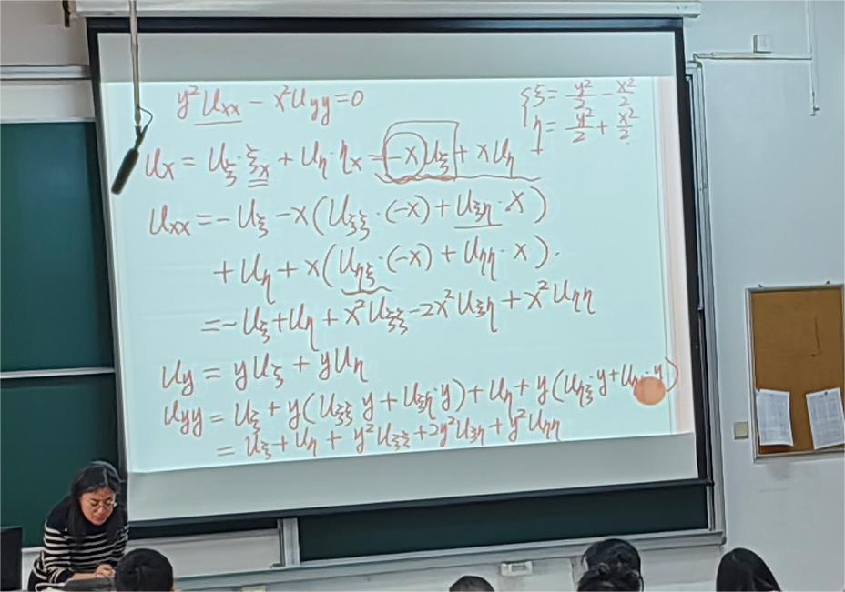

Slide 12
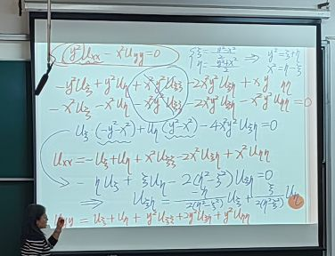

Slide 13
2. Simplification of linear second order PDEs
Example 2.
Solution.
(1) Evaluate the discriminant.
parabolic type
(2) Write down its characteristic equation.
Characteristic curve:
(3) Take the transformation.

Slide 15
2. Simplification of linear second order PDEs
Example 3.
Solution.
(1) Evaluate the discriminant.
elliptic type
(2) Write down its characteristic equation.
Characteristic curve:
(3) Take the transformation.

Slide 17
2. Simplification of linear second order PDEs
Remark:
The type of one equation may be different in different range.
For example:
The Tricomi equation

Slide 18
3. The general solution of linear second order PDEs
Example 1.
Solution.
(1) Evaluate the discriminant.
hyperbolic type
(2) Write down its characteristic equation.
Characteristic lines:
(3) Take the transformation.
Standard form

Slide 19
3. The general solution of linear second order PDEs
Example 1.
Solution (cont.)
(4) Find the general solution.
This is an ODE.
The general solution is

Slide 20
3. The general solution of linear second order PDEs
Example 2.
Solution.
(1) Evaluate the discriminant.
parabolic type
(2) Write down its characteristic equation.
Characteristic curve:
(3) Take the transformation.
Standard form

Slide 21
3. The general solution of linear second order PDEs
Example 2.
Solution (cont.)
(4) Find the general solution.
The general solution is

Slide 22
4. Summary
(i) Classification of the linear second order PDEs.
(ii) Simplification of the linear second order PDEs.
(iii) The general solution of the linear second order PDEs.

Slide 23
and
Return

Slide 24
Return

